Slide 1
IMP 學習進度報告
2023.08.14 ~ 2023.08.25

Slide 2
一、兩周 IMP 學習內容
日期 | 機台 | 學習內容
08/14(一) | 6200-1 | T-POWER on ARC current 6.xxA issue，replace filament P.S body + filament P.S control PCB
08/15(二) | E500-1 | PH3 gas flow issue，PH3 鋼瓶改至 ASH3 位置、replace MFC、 RP1 pump 異音，replace pump
08/16(三) | GSD-5 | Holder forward time out issue，cylinder 連接處再鎖緊
08/17(四) | GSD-1 | MPM，clean beam guide chamber、replace exhaust tube、 replace source chamber release valve o-ring
08/18(五) | GSD-4 | HR OOC issue，測漏 faraday seal leak，replace spare faraday
08/21(一) | E500-3 E500-1 | E500-3 460KV arcing issue，replace exhaust tube E500-1 decel arcing issue，decel relay cable 破皮，絕緣膠帶 cover
08/22(二) | RTP-M | 支援 RTP-M YPM，replace quartz tube & demo metal seal 灌膠
08/23(三) | 6200-2 | WPM，replace source & electrode & 詰源 repair bushing、 replace accel/decel feed assy & suppression net、 replace repair 葳鎧 repair H card
08/24(四) | GSD-5 | MPM，replace exhaust tube、RTP-4 測試健力 servo amplifier*3
08/25(五) | E500-1 | MPM，clean beam guide chamber、抓漏 source & beam line 端

Slide 3
二、IMP 學習進度

Slide 4
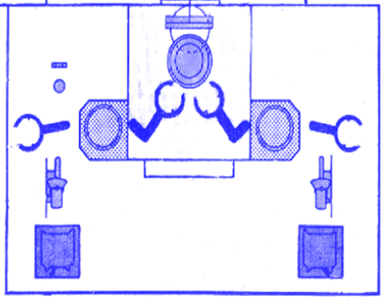
三、6200 傳送簡介
CHUCK 1、2
FLAT
INPUT LOADLOCK
OUPUT LOADLOCK
INPUT TRANSFER
OUPUT TRANSFER
LOAD ARM
UNLOAD ARM
INPUT SHUTTLE
OUPUT SHUTTLE
LOAD CASSETTE
UNLOAD CASSETTE

Slide 5
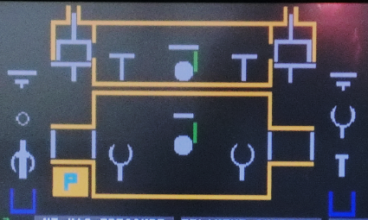
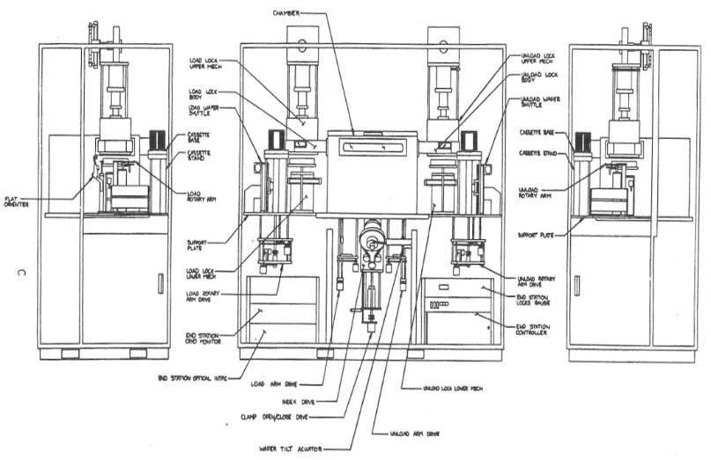
IN AIR
→ INPUT SHUTTLE → LOAD CASSETTE → INPUT TRANSFER → FLAT → INPUT LOCK DOWN
→ INPUT LOADLOCK
IN VACUUM
→ INPUT LOCK UP → ROUGH → BELL UP → LOAD ARM → CHUCK → CLAMP
植入
IN VACUUM
→ UNCLAMP → UNLOAD ARM → OUTPUT LOADLOCK → BELL DOWN → VENT
IN AIR
→ OUTPUT LOCK DOWN → OUTPUT TRANSFER → OUTPUT SHUTTLE → OUTPUT CASSETTE

Slide 6
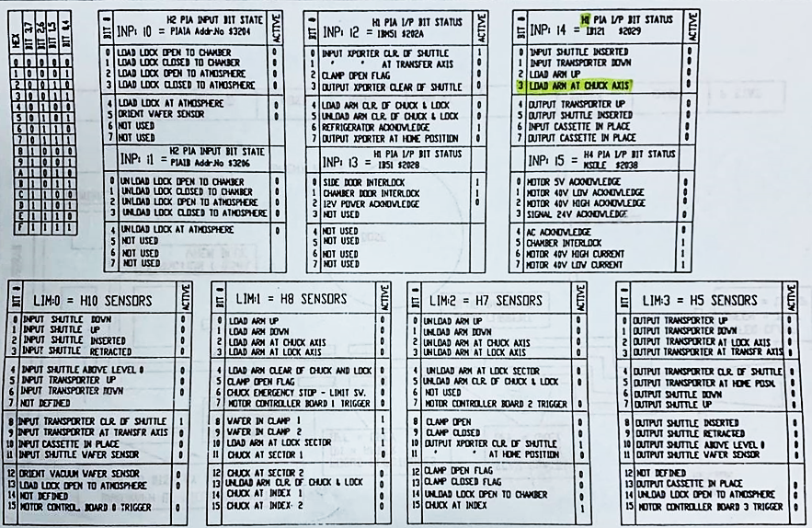
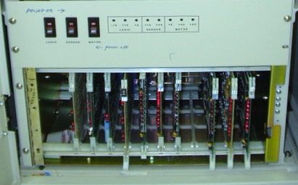
END STATION CONTROLLER
Control board 功能：
H10 (INPUT IN AIR)
H9 (ENDSTATION READ-BACK CIRCUITS)
H8 (IN PUT IN VAC)
H7 (OUTPUT IN VAC)
H6 (ENDSTATION READ-BACK CIRCUITS)
H5 (OUTPUT IN AIR)
H4 (MOTOR 5/40V LOW/HI CURRENT SIGNAL 24V SOLENOID DRIVE I/O)
H3 (I/O port COMMUNICATION)
H2 (LOADLOCK/UNLOAD LOCK OPEN/CLOSE TO CHAMBER/ATM、
ORIENT WAFER SENSOR)
H1 (LOAD/UNLOAD ARM CLR. OF CHUCK、DOOR INTERLOCK、
12V POWER、INPUT/OUTPUT SHUTTLE CLR.、
INPUT/OUTPUT CASSETTE IN PLACE、INPUT SHUTTLE/TR DOWN、
OUTPUT SHUTTLE/TR UP、CLAMP OPEN FLAG)
H1
H10

Slide 7
四、E500 傳送簡介

Slide 8
LOAD 程序：
→ PIVOT RETRACT → DOOR CLOSE → ROUGH → TURBO HI VAC
→ SIDE 選 LEFT or RIGHT → 選 SLOT → ELEVATOR CLEAR (類似 WSIX BASE)
→ LOWER HANDLER CASSETTE → ELEVATOR LOFT (類似 WSIX DELTA)
→ LOWER HANDLER ORIENTER → ORIENTER UP → ORIENT
→ UPPER HANDLER ORIENTER → ORIENTER DOWN → UPPER HANDLER PLATEN
→ ROPINS UP → UPPER HANDLER IDLE → ROPINS DOWN → BEARING ROTATE
→ E-CLAMP CLAMP → HEAD IMPLANT
植入
UNLOAD 程序：
→ HEAD UNLAOD → BEARING UNLOAD → E-CLAMP UNCLAMP → ROPINS UP
→ LOWER HANDLER PLATEN → ROPINS DOWN → LOWER HANDLER ORIENTER
→ ELEVATOR LOFT → LOWER HANDLER CASSETTE → ELEVATOR CLEAR
→ LOWER HANDLER ORIENTER → VENT → DOOR OPEN → ELEVATOR PIVOT
→ PIVOT EXTEND

Slide 9
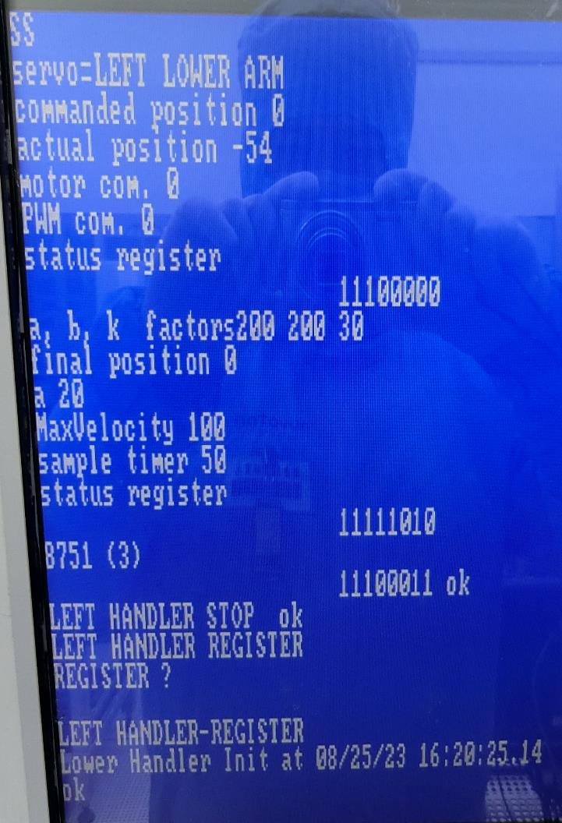
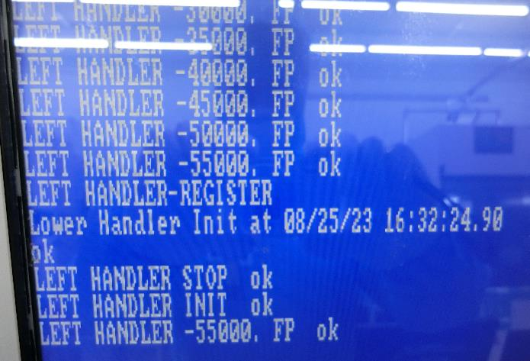
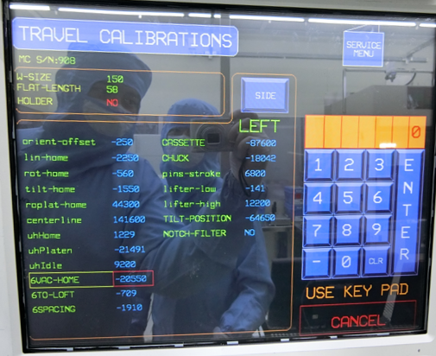

Slide 10
五、GSD 傳送簡介
IN AIR 傳送程序：
Vacuum Cassette
Load Buffer
Dummy
Robot
Aligner
Table

Slide 11
IN AIR → IN VAC 傳送程序：
Disk Chamber
Load Buffer
Aligner
Holder
Robot
Table
Arm
Vac Cassette
Dummy

Slide 12
IN AIR
→ LOAD CASSETTE TO TABLE → PLACE CASSETTE → ALIGNER → VACUUM CASSETTE
→ ELEVATOR DOWN → STAND HORIZON → STAND CLOSE
IN VACUUM
→ ROUGH SEQ. → ARM CHUCK SEQ. → ARM UP → ARM DISK CHUCK → HOLDER OPEN
→ HOLDER CENTER → HOLDER CLOSE → ARM RELEASE SEQ. → HOLDER BACKWARD
→ ARM CASSETTE RELEASE → CLAMP OPEN → HOLDER FORWARD → CLAMP CLOSE
→ HOLDER OPEN → HOLDER BACKWARD
植入
IN VACUUM
→ ARM DISK RELEASE → ARM FORWARD → ARM CHUCK SEQ. → CLAMP OPEN
→ ARM BACKWARD → ARM CASSETTE CHUCK → ARM DOWN → ARM RELEASE SEQ.
→ VENT SEQ.
IN AIR
→ STAND OPEN → STAND VERTICAL→ ELEVATOR UP → VACUUM CASSETTE → TABLE
→ REMOVE CASSETTE
CASSETTE CHUCK：ARM 上有 WAFER 移至CASSETTE
DISK CHUCK：ARM 上有 WAFER 移至 DISK
CASSETTE RELEASE：ARM 上沒有 WAFER 移至 CASSETTE
DISK RELEASE：ARM 上沒有 WAFER 移至 DISK

